Slide 1

UNFI Easy Options Registration & Ordering Instructions
4/30/20

Slide 2
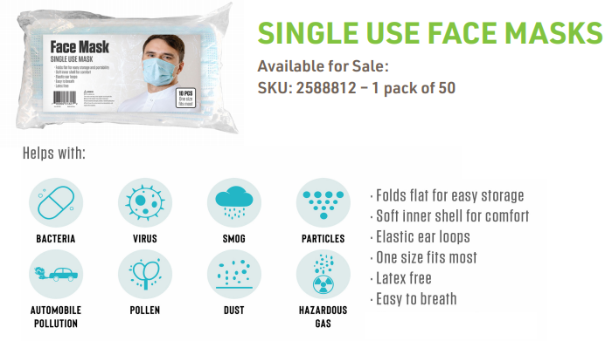
Overview
UNFI is providing IGA stores with access to the Easy Options eCommerce website for the purpose of ordering face masks
Single-use face masks will be available for sale in single packs of 50
We’ve made some adjustments to our normal registration process in order to accommodate IGA
The purpose of this presentation is to outline the registration process, what to expect and how to order the masks once the account registration is approved

Slide 3
Registering an Account with UNFI Easy Options

Slide 4
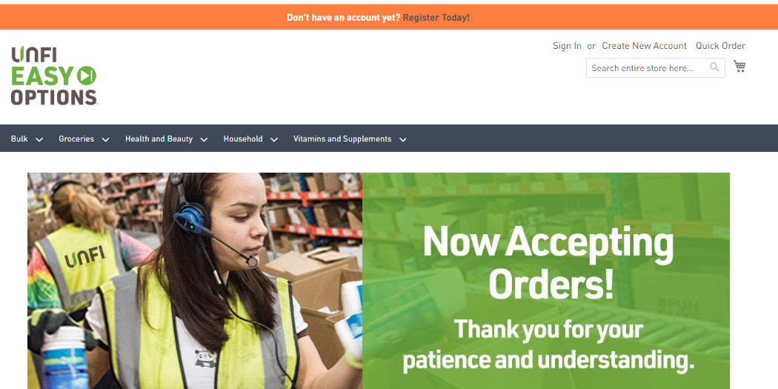
UEO Registration Process
Step 1:
Go to the UNFI Easy Options website: https://unfieasyoptions.com/
Step 2:
Click on “Create New Account” in upper right corner

Slide 5
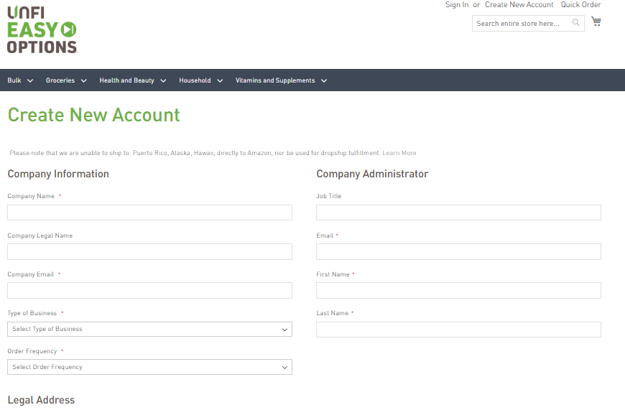
UEO Registration Process
Step 3:
Fill out form:
Company Information
Legal Address
Company Administrator
Note:
You only need to fill in fields with a red asterisk.

Slide 6
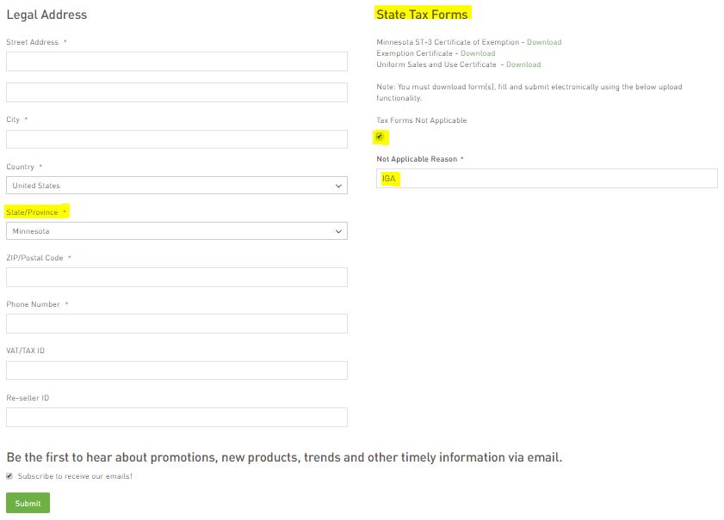
UEO Registration Process
Step 4:
Under the Legal Address section, when entering your state, a State Tax Forms section will appear on the right.
You do not need to provide any tax forms to register, but it is important that you do the following:
Check the “Tax Forms Not Applicable” box
In the “Not Applicable Reason” box, please enter “IGA”
Step 5:
Click the green “Submit” button

Slide 7
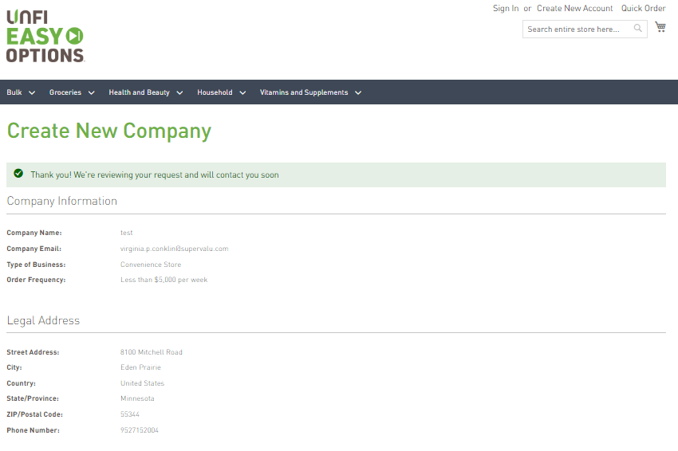
UEO Registration Process
Step 6:
After clicking the “Submit” button, you will see a confirmation page with a summary of the company info you submitted

Slide 8
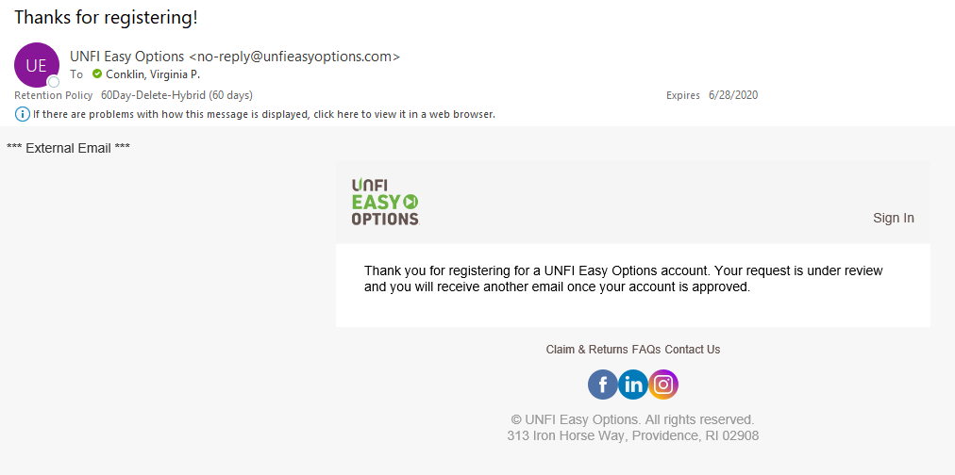
UEO Registration Process
Step 7:
Within a minute after clicking the “Submit” button, you will receive a confirmation email that your account registration application has been received and is under review.

Slide 9
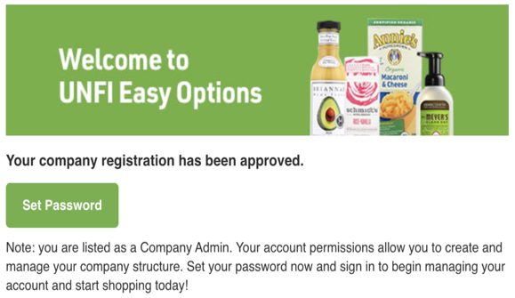
UEO Registration Process
Step 8:
Your registration application will be approved within one business day of receipt – this auto-generated email will be sent to you
Step 9:
Click “Set Password” and set your password on the site. You are now registered and can begin ordering!
THIS CONCLUDES THE REGISTRATION PROCESS

Slide 10
Placing an Order on UNFI Easy Options

Slide 11
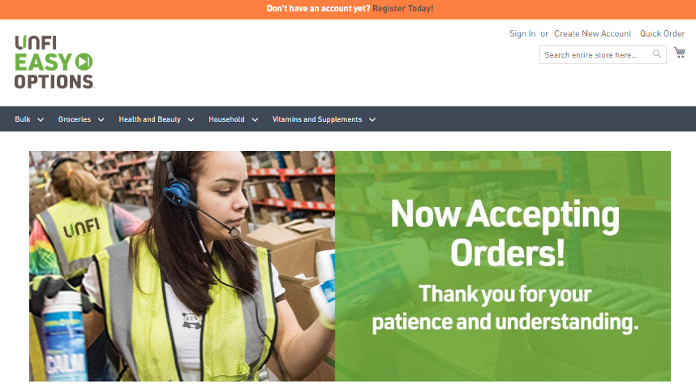
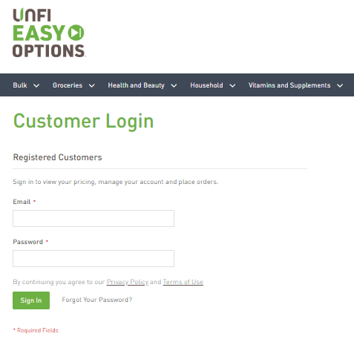
UEO Ordering Process
Step 1:
Make sure you are signed in to your account on https://unfieasyoptions.com/

Slide 12
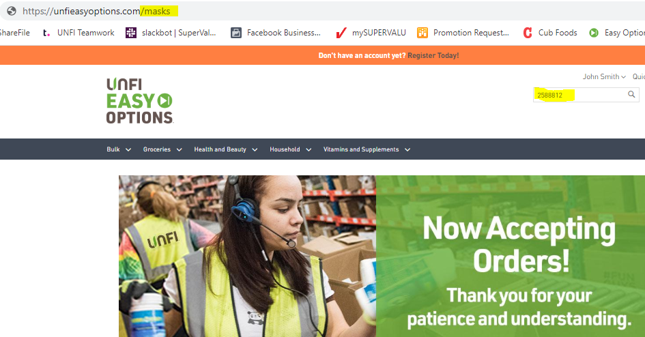
UEO Ordering Process
Step 2:
Locate the face mask product in one of two ways:
Type the SKU (2588812) directly into the search bar
- or -
Type in “/masks” at the end of the URL in the browser
https://unfieasyoptions.com/masks

Slide 13
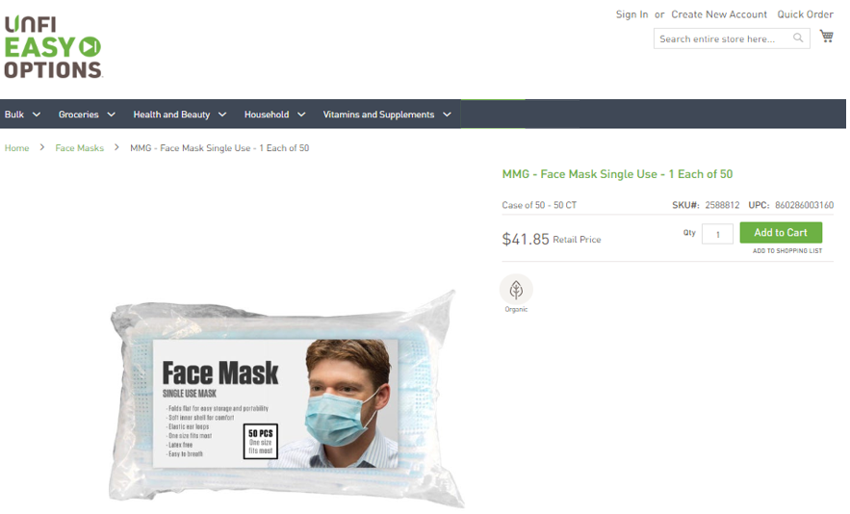
UEO Ordering Process
Step 3:
Add the product to your cart and proceed to check out

Slide 14
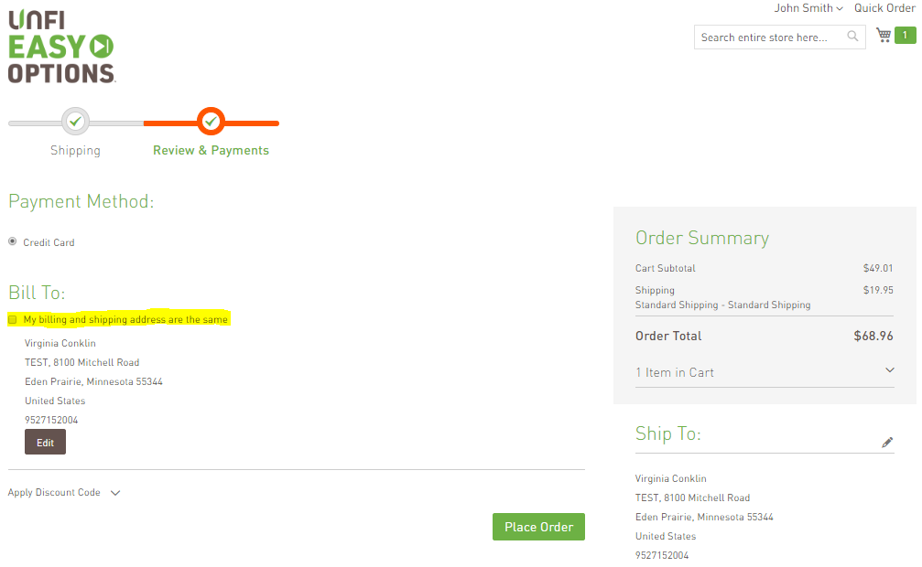
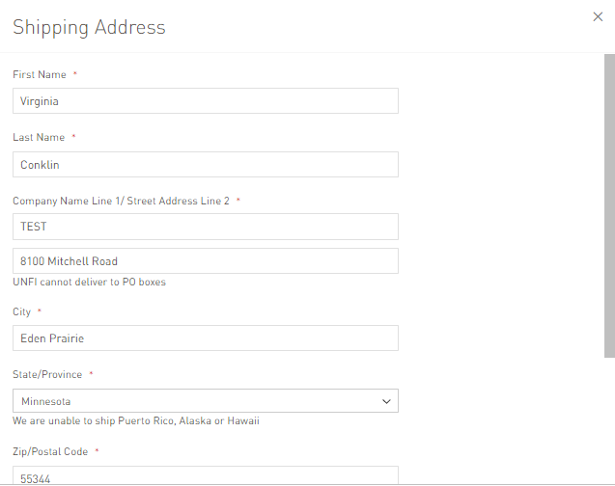
UEO Ordering Process
Step 4:
Enter your shipping address; click the “next” button
Step 5:
Check the box “My billing and shipping address are the same”; click the green “Place Order” button

Slide 15
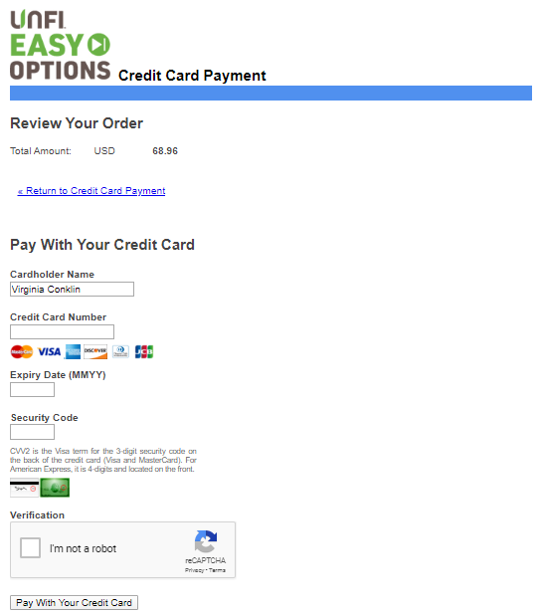
UEO Ordering Process
Step 6:
Fill out your credit card payment information and click “Pay with Your Credit Card” at the bottom

Slide 16
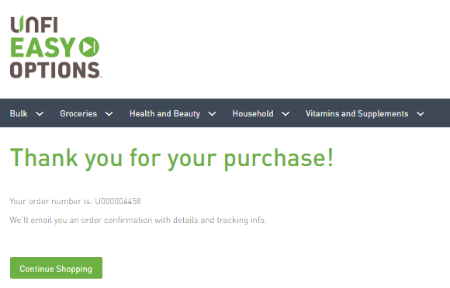
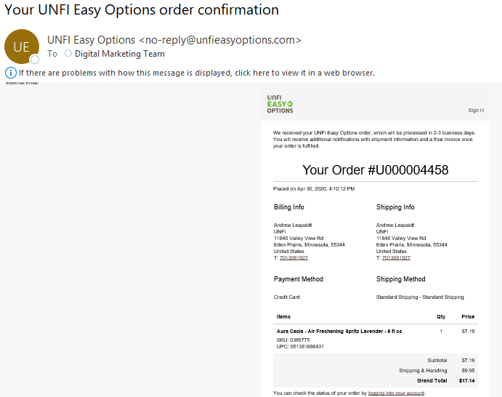
UEO Ordering Process
Step 7:
An order confirmation screen will appear with your order number
Step 8:
An order confirmation email will be auto-generated and sent your inbox
THIS CONCLUDES THE ORDERING PROCESS

Slide 17
Thank you
Corporate Headquarters:
313 Iron Horse Way, Providence, RI 02908
11840 Valley View Rd, Eden Prairie, MN 55344

